Slide 2
Convention for Getters/Setters and Constructors
The constructor, getter and setter functions for a private data member called xxx of type T in a class Aaa have the following conventions:
class Aaa {
private:
T xxx; // A private variable named xxx of type T
public:
Aaa(T x) { xxx = x; } // Constructor
Aaa(T xxx) { this->xxx = xxx; } // OR
Aaa(T xxx) : xxx(xxx) { } // OR using member initializer list
// A getter for variable xxx of type T receives no argument and return a value of type T
T getXxx() const { return xxx; }
// A setter for variable xxx of type T receives a parameter of type T and return void
void setXxx(T x) { xxx = x; }
void setXxx(T xxx) { this->xxx = xxx; }
}

Slide 3
For a bool variable xxx, the getter shall be named isXxx(), instead of getXxx(), as follows:
private:
// Private boolean variable
bool xxx;
public:
// Getter
bool isXxx() const { return xxx; }
// Setter
void setXxx(bool x) { xxx = x; }
// OR
void setXxx(bool xxx) { this->xxx = xxx; }

Slide 4
Default Constructor
A default constructor is a constructor with no parameters, or having default values for all the parameters. For example, Circle's constructor can be served as default constructor with all the parameters default.
Circle c1; // Declare c1 as an instance of Circle, and invoke the default constructor
Circle c1(); // Error!
// (This declares c1 as a function that takes no parameter and returns a Circle instance)
If C++, if you did not provide ANY constructor, the compiler automatically provides a default constructor that does nothing. That is,
ClassName::ClassName() { } // Take no argument and do nothing
Compiler will not provide a default constructor if you define any constructor(s).
If all the constructors you defined require arguments, invoking no-argument default constructor results in error.
This is to allow class designer to make it impossible to create an uninitialized instance, by NOT providing an explicit default constructor.

Slide 5
Constructor's Member Initializer List
Instead of initializing the private data members inside the body of the constructor, as follows:
Circle(double r = 1.0, string c = "red") {
radius = r;
color = c;
}
We can use an alternate syntax called member initializer list as follows:
Circle(double r = 1.0, string c = "red") : radius(r), color(c) { }
Member initializer list is placed after the constructor's header, separated by a colon (:).
Each initializer is in the form of data_member_name(parameter_name).
For fundamental type, it is equivalent to data_member_name = parameter_name.
For object, the constructor will be invoked to construct the object. The constructor's body (empty in this case) will be run after the completion of member initializer list.
It is recommended to use member initializer list to initialize all the data members, as it is often more efficient than doing assignment inside the constructor's body.

Slide 6

#include<iostream> using namespace std;
class Point {
private:
int x;
int y;
public:
Point(int i = 0, int j = 0) :x(i), y(j) {}
/* The above use of Initializer list is optional as the constructor can also be written as:
Point(int i = 0, int j = 0) {
x = i;
y = j;
} */
int getX() const { return x; }
int getY() const { return y; }
};
int main() {
Point t1(10, 15);
cout << "x = " << t1.getX() << ", ";
cout << "y = " << t1.getY();
return 0;
}

Slide 7
Destructor
A destructor, similar to constructor, is a special function that has the same name as the classname, with a prefix ~, e.g., ~Circle().
Destructor is called implicitly when an object is destroyed.
If you do not define a destructor, the compiler provides a default, which does nothing.
class MyClass {
public:
// The default destructor that does nothing
~MyClass() { }
......
}

Slide 8
Copy Constructor
A copy constructor constructs a new object by copying an existing object of the same type. In other words, a copy constructor takes an argument, which is an object of the same class.
If you do not define a copy constructor, the compiler provides a default which copies all the data members of the given object. For example,
Circle c4(7.8, "blue");
cout << "Radius=" << c4.getRadius() << " Area=" << c4.getArea() << " Color=" << c4.getColor() << endl;
// Radius=7.8 Area=191.135 Color=blue
// Construct a new object by copying an existing object via the so-called default copy constructor
Circle c5(c4);
cout << "Radius=" << c5.getRadius() << " Area=" << c5.getArea() << " Color=" << c5.getColor() << endl;
// Radius=7.8 Area=191.135 Color=blue
The copy constructor is particularly important. When an object is passed into a function by value, the copy constructor will be used to make a clone copy of the argument.

Slide 9
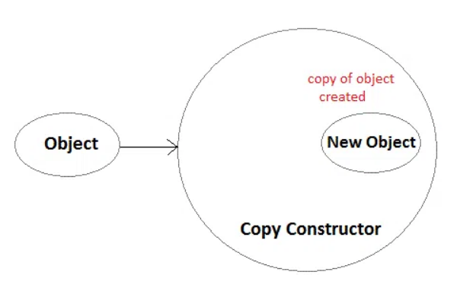
What is a copy constructor?
A copy constructor is a member function which initializes an object using another object of the same class. A copy constructor has the following general function prototype:
ClassName (const ClassName &old_obj);
As it is used to create an object, hence it is called a constructor. And, it creates a new object, which is exact copy of the existing copy, hence it is called copy constructor.

Slide 10
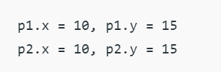
class Point{
private:
int x, y;
public:
Point(int x1, int y1) { x = x1; y = y1; }
// Copy constructor
Point(const Point &p1) {x = p1.x; y = p1.y; }
int getX() { return x; }
int getY() { return y; }
};
int main(){
Point p1(10, 15); // Normal constructor is called here
Point p2 = p1; // Copy constructor is called here
// Let us access values assigned by constructors
cout << "p1.x = " << p1.getX() << ", p1.y = " << p1.getY();
cout << "\np2.x = " << p2.getX() << ", p2.y = " << p2.getY();
return 0;
}

Slide 11
#include <iostream> using namespace std;
class ABC
{
public: int x;
ABC (int a){ // this is parameterized constructor
x=a;
}
ABC (ABC &i){ // this is copy constructor
x = i.x;
}
};
int main ()
{
ABC a1(40); // Calling the parameterized constructor.
ABC a2(a1); // Calling the copy constructor.
cout<<a2.x;
return 0;
}

Slide 12

#include <iostream> using namespace std;
class Wall {// declare a class
private:
double length; double height;
public:
Wall(double len, double hgt) {// parameterized constructor to initialize variables
length = len; height = hgt;
}
double calculateArea() {
return length * height;
}
};
int main() {
Wall wall1(10.5, 8.6); // create object and initialize data members
Wall wall2(8.5, 6.3);
cout << "Area of Wall 1: " << wall1.calculateArea() << endl; cout << "Area of Wall 2: " << wall2.calculateArea();
return 0; }

Slide 13

#include <iostream> using namespace std;
class Wall {// declare a class
private:
double length; double height;
public:
Wall(double len, double hgt) {// initialize variables with parameterized constructor
length = len;
height = hgt;
}
// copy constructor with a Wall object as parameter
// copies data of the obj parameter
Wall(Wall &obj) {
length = obj.length;
height = obj.height;
}
double calculateArea() {
return length * height;
}
};
int main() {
// create an object of Wall class
Wall wall1(10.5, 8.6);
// copy contents of wall1 to wall2
Wall wall2 = wall1;
// print areas of wall1 and wall2
cout << "Area of Wall 1: " << wall1.calculateArea() << endl;
cout << "Area of Wall 2: " << wall2.calculateArea();
return 0;
}

Slide 15
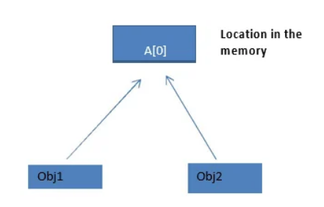
There are two ways in which copy constructor copies, and they are:
Shallow copy.
Two students are entering their details in excel sheet simultaneously from two different machines shared over a network. Changes made by both of them will be reflected in the excel sheet. Because same excel sheet is opened in both locations. This is what happens in shallow copy constructor. Both objects will point to same memory location.

Slide 16
#include <iostream> using namespace std;
class Opp {
int a;
int b;
int *z;
public: Opp() {
z=new int;
}
void input(int x, int y, int l) {
a=x;
b=y;
*z=l;
}
void display() {
cout<<"value of a:" <<a<<endl;
cout<<"value of b:" <<b<<endl;
cout<<"value of z:" <<*z<<endl;
}
};
obj1 Shallow copy obj 2
int main() {
Opp obj1;
obj1.input(4,8,12);
Opp obj2 = obj1;
obj2.display();
return 0;
}

Slide 17
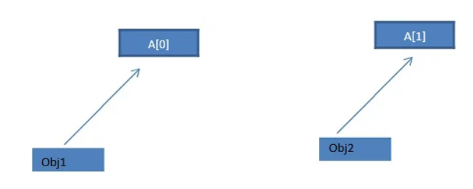
Deep copy.
You are supposed to submit an assignment tomorrow and you are running short of time, so you copied it from your friend. Now you and your friend have same assignment content, but separate copies. Therefore any modifications made in your copy of assignment will not be reflected in your friend's copy. This is what happens in deep copy constructor.

Slide 18
#include<iostream>
using namespace std;
class Number {
private: int a;
public: Number(){} //default constructor
Number(int n){
a=n;
}
Number(Number &x) {
a=x.a;
cout<<"copy constructor is invoked";
}
void display() {
cout<<"value of a:"<<a<<endl;
}
};
N1 and N2 are the two objects. ‘N2’ is the object which stores the value of objec’N1’. ‘N1’ takes 100 as input and will initialise to ‘N2’. ➢ Both N1 and N2 will have different locations.
int main() {
// create an object and assign value to member variable
Number N1(100);
Number N2(N1); // invoke user defined copy constructor
N1.display ();
N2.display ();
return 0;
}

Slide 19
Advanced Notes
Pass-by-value for object means calling the copy constructor.
To avoid the overhead of creating a clone copy, it is usually better to pass-by-reference-to-const, which will not have side effect on modifying the caller's object.
The copy constructor has the following signature:
class MyClass {
private:
T1 member1;
T2 member2;
public:
// The default copy constructor which constructs an object via memberwise copy
MyClass(const MyClass & rhs) {
member1 = rhs.member1;
member2 = rhs.member2;
}
......
}

Slide 20
Copy Assignment Operator (=)
The compiler also provides a default assignment operator (=), which can be used to assign one object to another object of the same class via memberwise copy. For example, using the Circle class defined earlier,
Circle c6(5.6, "orange"), c7;
cout << "Radius=" << c6.getRadius() << " Area=" << c6.getArea()
<< " Color=" << c6.getColor() << endl;
// Radius=5.6 Area=98.5206 Color=orange
cout << "Radius=" << c7.getRadius() << " Area=" << c7.getArea()
<< " Color=" << c7.getColor() << endl;
// Radius=1 Area=3.1416 Color=red (default constructor)
c7 = c6; // memberwise copy assignment
cout << "Radius=" << c7.getRadius() << " Area=" << c7.getArea()
<< " Color=" << c7.getColor() << endl;
// Radius=5.6 Area=98.5206 Color=orange

Slide 22
Separating Header and Implementation
For better software engineering, it is recommended that the class declaration and implementation be kept in 2 separate files: declaration is a header file ".h"; while implementation in a ".cpp".
This is known as separating the public interface (header declaration) and the implementation.
Interface is defined by the designer, implementation can be supplied by others.
While the interface is fixed, different vendors can provide different implementations.
Furthermore, only the header files are exposed to the users, the implementation can be provided in an object file ".o" (or in a library).
The source code needs not given to the users.

Slide 23
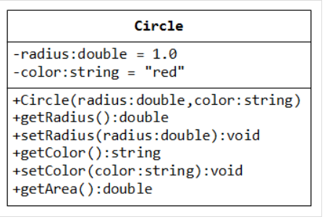
Example: The Circle Class
Instead of putting all the codes in a single file. We shall "separate the interface and implementation" by placing the codes in 3 files.
Circle.h: defines the public interface of the Circle class.
Circle.cpp: provides the implementation of the Circle class.
TestCircle.cpp: A test driver program for the Circle class.

Slide 24
/* The Circle class Header (Circle.h) */
#include <string> // using string
using namespace std;
class Circle {// Circle class declaration
private: // Accessible by members of this class only
double radius; // private data members (variables)
string color;
public: // Accessible by ALL
// Declare prototype of member functions // Constructor with default values
Circle(double radius = 1.0, string color = "red");
// Public getters & setters for private data members
double getRadius() const;
void setRadius(double radius);
string getColor() const;
void setColor(string color);
// Public member Function
double getArea() const;
};

Slide 25
#include "Circle.h" // user-defined header in the same directory
Circle::Circle(double r, string c) {// Constructortion
radius = r; color = c;
}
double Circle::getRadius() const {// Public getter for private data member radius
return radius;
}
void Circle::setRadius(double r) {// Public setter for private data member radius
radius = r;
}
string Circle::getColor() const {// Public getter for private data member color
return color;
}
void Circle::setColor(string c) {// Public setter for //private data member color
color = c;
}
double Circle::getArea() const {// A public member function
return radius*radius*3.14159265;
}

Slide 26
/* A test driver for the Circle class (TestCircle.cpp) */
#include <iostream>
#include "Circle.h" // using Circle class
using namespace std;
int main() {
Circle c1(1.2, "red"); // Construct an instance of Circle c1
cout << "Radius=" << c1.getRadius() << " Area=" << c1.getArea()
<< " Color=" << c1.getColor() << endl;
c1.setRadius(2.1); // Change radius and color of c1
c1.setColor("blue");
cout << "Radius=" << c1.getRadius() << " Area=" << c1.getArea()
<< " Color=" << c1.getColor() << endl;
// Construct another instance using the default constructor
Circle c2;
cout << "Radius=" << c2.getRadius() << " Area=" << c2.getArea()
<< " Color=" << c2.getColor() << endl;
return 0;
}

Slide 27
Program Notes:
The implementation file provides the definition of the functions, which are omitted from the declaration in the header file.
#include "Circle.h"
The compiler searches the headers in double quotes (such as "Circle.h") in the current directory first, then the system's include directories. For header in angle bracket (such as <iostream>), the compiler does NOT searches the current directory, but only the system's include directories. Hence, use double quotes for user-defined headers.
Circle::Circle(double r, string c) {
You need to include the className:: (called class scope resolution operator) in front of all the members names, so as to inform the compiler this member belong to a particular class.
(Class Scope: Names defined inside a class have so-called class scope. They are visible within the class only. Hence, you can use the same name in two different classes. To use these names outside the class, the class scope resolution operator className:: is needed.)
You CANNOT place the default arguments in the implementation (they shall be placed in the header). For example,
Circle::Circle(double r = 1.0, string c = "red") { // error!

Slide 29
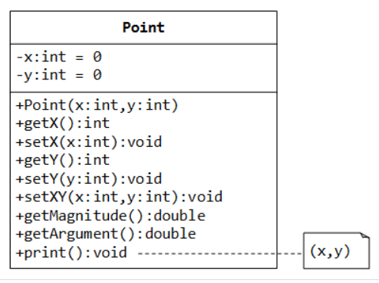
Example: The Point Class
The Point class, as shown in the class diagram, models 2D points with x and y co-ordinates.
In the class diagram, "-" denotes private member; "+" denotes public member. "= xxx" specifies the default value of a data member.
The Point class contains the followings:
Private data members x and y (of type int), with default values of 0.
A constructor, getters and setters for private data member x and y.
A function setXY() to set both x and y coordinates of a Point.
A function print() which prints "(x,y)" of this instance.

Slide 30
/* The Point class Header (Point.h) */
#ifndef POINT_H
#define POINT_H
class Point {// Point class declaration
private:
int x; // private data members (variables)
int y;
public:
// Declare member function prototypes
Point(int x = 0, int y = 0); // Constructor with default values
int getX() const;
void setX(int x);
int getY() const;
void setY(int y);
void setXY(int x, int y);
double getMagnitude() const;
double getArgument() const;
void print() const;
};
#endif

Slide 31
/* The Point class Implementation (Point.cpp) */
#include "Point.h" // user-defined header in the same directory
#include <iostream>
#include <cmath>
using namespace std;
// Constructor (default values can only be specified in the declaration)
Point::Point(int x, int y) : x(x), y(y) { } // Use member initializer list
int Point::getX() const {// Public getter for private data member x
return x;
}
void Point::setX(int x) {// Public setter for private data member x
this->x = x;
}
int Point::getY() const {// Public getter for private data member y
return y;
}

Slide 32
void Point::setY(int y) { // Public setter for private data member y
this->y = y;
}
void Point::setXY(int x, int y) { // Public member function to set both x and y
this->x = x;
this->y = y;
}
double Point::getMagnitude() const { // Public member function to return the magitude
return sqrt(x*x + y*y} ); // sqrt in <cmath>
double Point::getArgument() const { // Public member function to return the argument
return atan2(y, x); // atan2 in <cmath>
}
void Point::print() const { // Public member function to print description about this point
cout << "(" << x << "," << y << ")" << endl;
}

Slide 33
/* A test driver for the Point class (TestPoint.cpp) */
#include <iostream>
#include <iomanip>
#include "Point.h" // using Point class
using namespace std;
int main() {
Point p1(3, 4); // Construct an instance of Point p1
p1.print();
cout << "x = " << p1.getX() << endl;
cout << "y = " << p1.getY() << endl;
cout << fixed << setprecision(2);
cout << "mag = " << p1.getMagnitude() << endl;
cout << "arg = " << p1.getArgument() << endl;
p1.setX(6);
p1.setY(8);
p1.print();
p1.setXY(1, 2);
p1.print();
Point p2; // Construct an instance of Point using default constructor
p2.print();
}

Slide 35
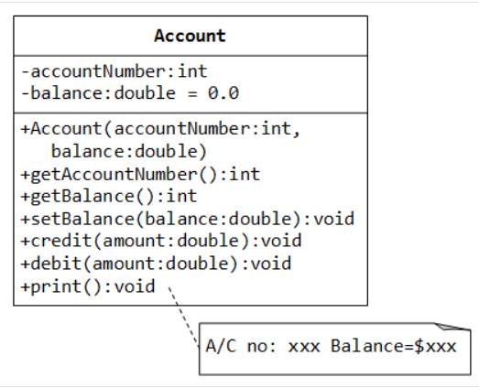
The Account Class
A class called Account, which models a bank account, is designed as shown in the class diagram. It contains:
Two private data members: accountNumber (int) and balance (double), which maintains the current account balance.
Public functions credit() and debit(), which adds or subtracts the given amount from the balance, respectively. The debit() function shall print "amount withdrawn exceeds the current balance!" if amount is more than balance.
A public function print(), which shall print "A/C no: xxx Balance=xxx" (e.g., A/C no: 991234 Balance=$88.88), with balance rounded to two decimal places.

Slide 36
/* Header for Account class (Account.h) */
#ifndef ACCOUNT_H
#define ACCOUNT_H
class Account {
private:
int accountNumber;
double balance;
public:
Account(int accountNumber, double balance = 0.0);
int getAccountNumber() const;
double getBalance() const;
void setBalance(double balance);
void credit(double amount);
void debit(double amount);
void print() const;
};
#endif

Slide 37
/* Implementation for the Account class (Account.cpp) */
#include <iostream>
#include <iomanip>
#include "Account.h"
using namespace std;
// Constructor
Account::Account(int no, double b) : accountNumber(no), balance(b) { }
// Public getter for private data member accountNumber
int Account::getAccountNumber() const {
return accountNumber;
}
// Public getter for private data member balance
double Account::getBalance() const {
return balance;
}

Slide 38
// Public setter for private data member balance
void Account::setBalance(double b) {
balance = b;
}
// Adds the given amount to the balance
void Account::credit(double amount) {
balance += amount;
}
// Subtract the given amount from the balance
void Account::debit(double amount) {
if (amount <= balance) {
balance -= amount;
} else {
cout << "Amount withdrawn exceeds the current balance!" << endl;
}
}
// Print description for this Account instance
void Account::print() const {
cout << fixed << setprecision(2);
cout << "A/C no: " << accountNumber << " Balance=$" << balance << endl;
}

Slide 39
/* Test Driver for Account class (TestAccount.cpp) */
#include <iostream>
#include "Account.h"
using namespace std;
int main() {
Account a1(8111, 99.99);
a1.print(); // A/C no: 8111 Balance=$99.99
a1.credit(20);
a1.debit(10);
a1.print(); // A/C no: 8111 Balance=$109.99
Account a2(8222); // default balance
a2.print(); // A/C no: 8222 Balance=$0.00
a2.setBalance(100);
a2.credit(20);
a2.debit(200); // Amount withdrawn exceeds the current balance!
a2.print(); // A/C no: 8222 Balance=$120.00
return 0;
}

Slide 41
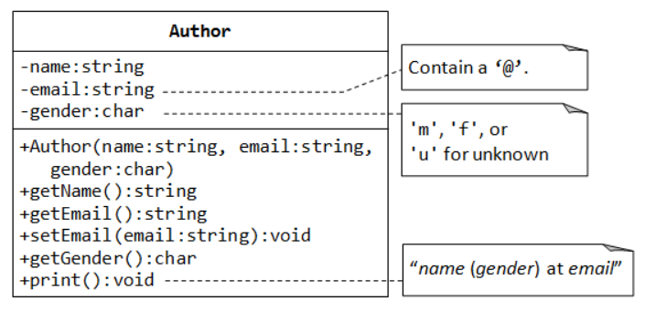
The Author and Book Classes (for a Bookstore)
Let's begin with a class called Author, designed as shown in the class diagram. It contains:
Three private data members: name (string), email (string), and gender (char of 'm', 'f' or 'u' for unknown).
A constructor to initialize the name, email and gender with the given values. There are no default values for data members.
Getters for name, email and gender, and setter for email. There is no setter for name and gender as we assume that these attributes cannot be changed.
A print() member function that prints "name (gender) at email", e.g., "Peter Jones (m) at peter@somewhere.com".

Slide 42
/* Header for the Author class (Author.h) */
#ifndef AUTHOR_H
#define AUTHOR_H
#include <string>
using namespace std;
class Author {
private:
string name;
string email;
char gender; // 'm', 'f', or 'u' for unknown
public:
Author(string name, string email, char gender);
string getName() const;
string getEmail() const;
void setEmail(string email);
char getGender() const;
void print() const;
};
#endif

Slide 43
/* Implementation for the Author class (Author.cpp) */
#include <iostream>
#include "Author.h"
using namespace std;
// Constructor, with input validation
Author::Author(string name, string email, char gender) {
this->name = name;
setEmail(email); // Call setter to check for valid email
if (gender == 'm' || gender == 'f') {
this->gender = gender;
} else {
cout << "Invalid gender! Set to 'u' (unknown)." << endl;
this->gender = 'u';
}
}
string Author::getName() const {
return name;
}

Slide 44
string Author::getEmail() const {
return email;
}
void Author::setEmail(string email) {
// Check for valid email. Assume that a valid email contains // a '@' that is not the first nor last character.
size_t atIndex = email.find('@');
if (atIndex != string::npos && atIndex != 0 && atIndex != email.length()-1) {
this->email = email;
} else {
cout << "Invalid email! Set to empty string." << endl;
this->email = "";
}
}
char Author::getGender() const {
return gender;
}
void Author::print() const {// print in the format "name (gender) at email"
cout << name << " (" << gender << ") at " << email << endl;
}

Slide 45
/* Test Driver for the Author class (TestAuthor.cpp) */
#include "Author.h"
int main() {
// Declare and construct an instance of Author
Author peter("Peter Jones", "peter@somewhere.com", 'm');
peter.print();
// Peter Jones (m) at peter@somewhere.com
peter.setEmail("peter@xyz.com");
peter.print();
// Peter Jones (m) at peter@xyz.com
Author paul("Paul Jones", "@somewhere.com", 'n');
// Invalid email! Set to empty string.
// Invalid gender! Set to 'u' (unknown).
paul.setEmail("paul@");
// Invalid email! Set to empty string.
paul.print();
// Paul Jones (u) at
}

